Slide 1
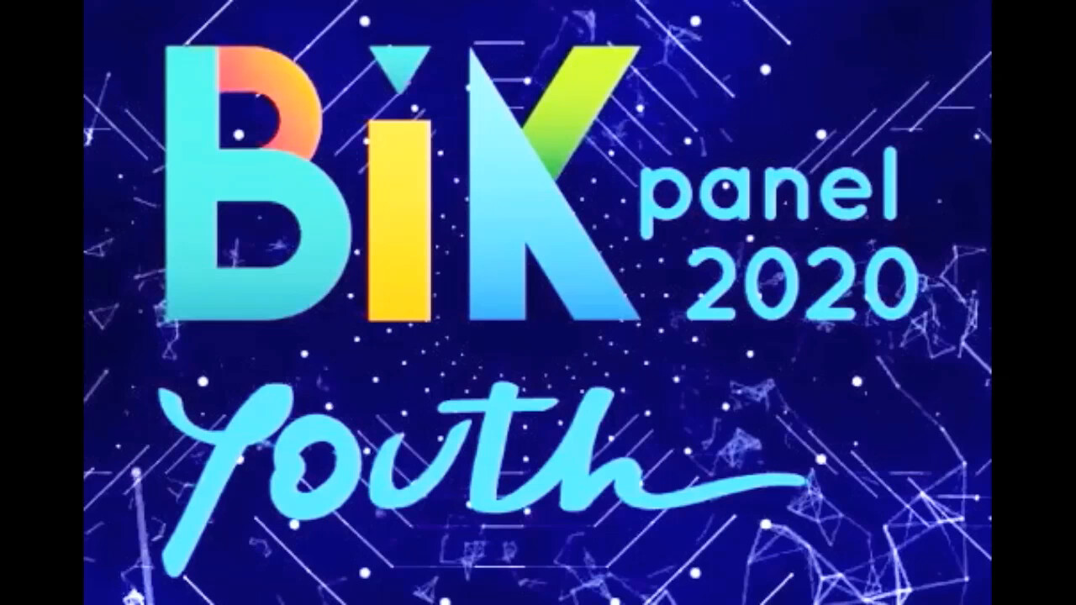

Slide 2
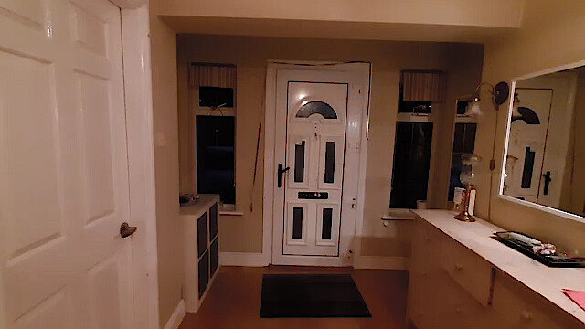


Slide 3

“Should Mia share this:
SHARE THIS TO GET AN IPHONE 12 FOR FREE! (credit card info required).“
Yes, it’s ok.
No it’s misleading

Slide 4

How to see if an advertisement is fake:
It asks for personal information.
If it sounds too good to be true, it is.
From an untrusted account.
Continue watching

Slide 5
“Banks oppose democracy, there is no other way of telling it.“
Mia should call the fake news police.
Mia should believe the news.

Slide 6
How to see if an article is fake:
No actual sources;
opinionized article;
the website is not https://
Continue watching

Slide 7
“ Less than 10% of Irish people are redheads.“
Mia should believe the news headline.
Mia should not believe the headline.

Slide 8
How to check if an article is real:
there are many sources that are listed and believable;
the article speaks about facts, not opinions;
the article is from an independent news source.
Continue...

Slide 9
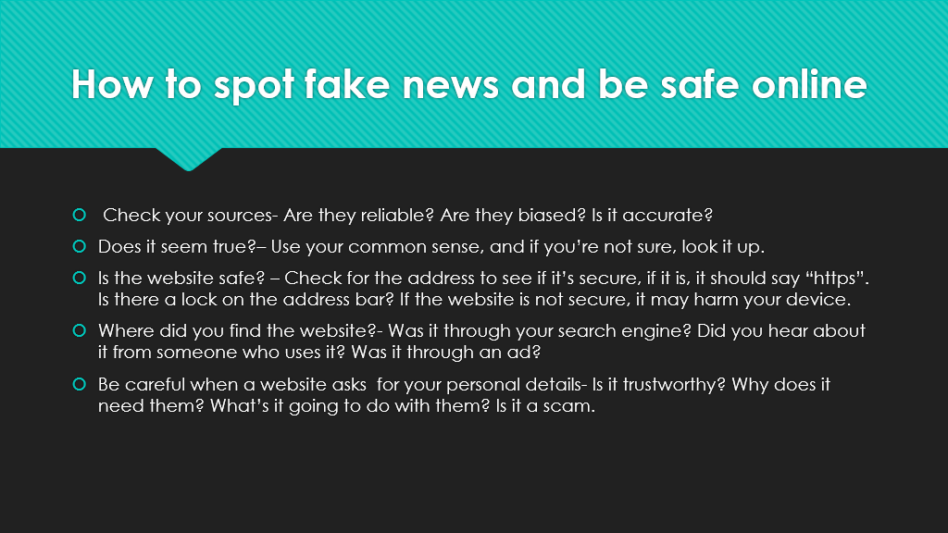

Slide 10
Credits
Aurimas, Piero – editor;
Mia Gibney – actress, narrator;
Baptiste – artist;
Alice – researcher;
Edgar, Molly – independent observers

